Slide 1

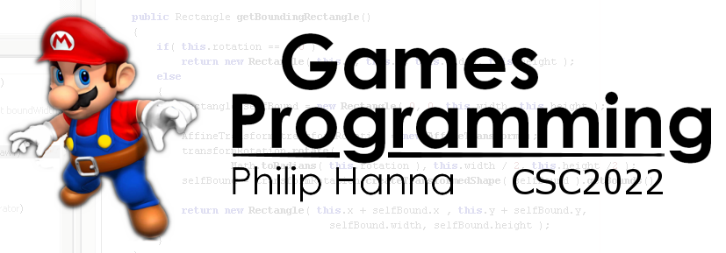
Viewports
Creating a window into your game world

Slide 2
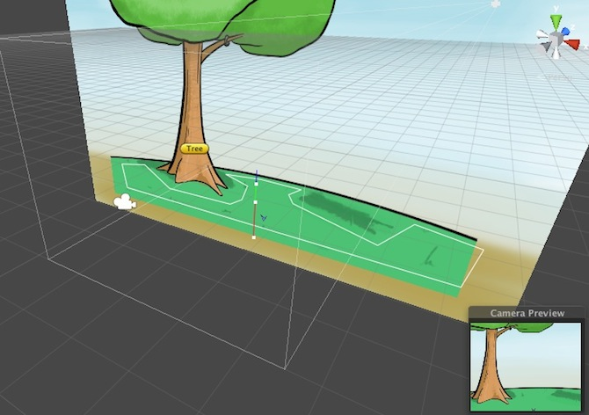
Viewports

Slide 3
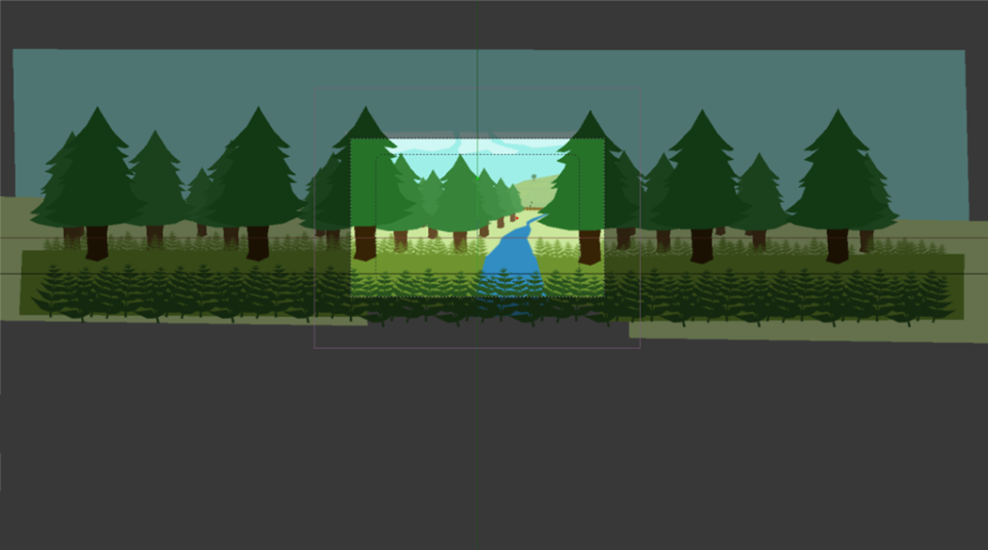
Viewport is just a window in your world
A viewport is a window into a game world. Game objects that fall within the viewport are assumed visible and drawn to the screen. By moving the viewport the player can change which areas of the game world they see.

Slide 4
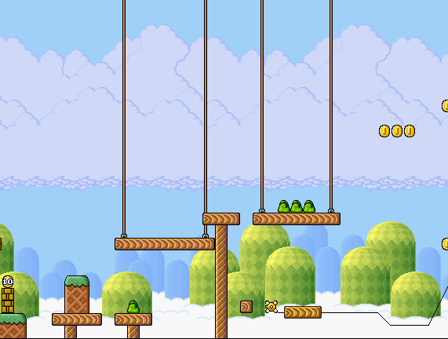
A viewport can be defined in a number of different ways:
By two points:
[left, top]
height
{top left, bottom right}
[centre_X, centre_Y]
Relative to a centre point:
{centre_X, centre_y, width, height}
width
[right, bottom]

Slide 5

Anything that falls within the viewport can be drawn:
if (mario.x - mario.width/2 <= viewport.x + viewport.width/2 &&
mario.x + mario.width/2 >= viewport.x - viewport.width/2 &&
mario.y – mario.height/2 <= viewport.y + viewport.height/2 &&
mario.y + mario.height/2 >= viewport.y - viewport.height/2) {
// It’s visible
}
height
height
[x, y]
[x, y]
width
width

Slide 6


Slide 7
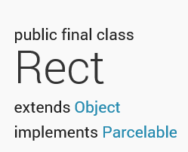
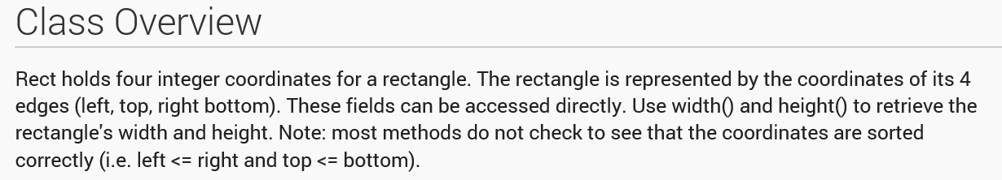
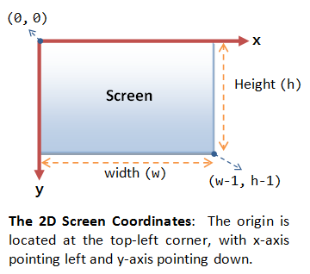
Consider the following text from the Android Rect class:
When specifying the location of texels within images or pixels on a screen, it is often assumed that (0,0) is the top-left coordinate and positive y points down the image/screen.
We will need to take this into account when mapping from our game world.

Slide 8
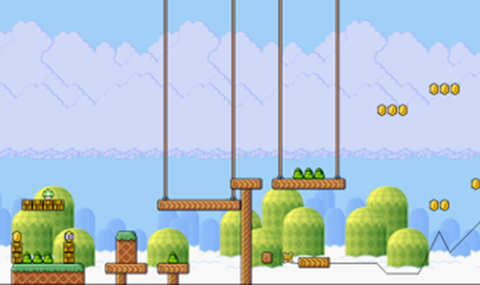
Working out which region of an image falls within the viewport:
sourceX = Max(0,
(view.x - view.width/2) – (mario.x - mario.width/2))
sourceY = Max(0,
(mario.y + mario.height/2) - (view.y + view.height/2))
sourceWidth = (mario.width - sourceX) - Max(0,
(mario.x + mario.width/2) - (view.x + view.width/2))
sourceHeight = (mario.height - sourceY) - Max(0,
(view.y - view.height/2) - (mario.y - mario.height/2))
[0, 0]
imageWidth
height
height
imageHeight
[x, y]
[x, y]
width
width
Building the source Rect for the bitmap
scaleX = mario.imageWidth / mario.width
scaleY = mario.imageHeight / mario.height
sourceRect = Rect( sourceX*scaleX, sourceY*scaleY,
(sourceX+sourceWidth)*scaleX, (sourceY+sourceHeight)*scaleY)

Slide 9
Working out the region of the screen we will draw to:
height
height
[x, y]
[x, y]
width
screenXScale = screenWidth / view.width
screenYScale = screenHeight / view.height
screenX = screenXScale * Max(0,
((mario.x - mario.width/2)
- (view.x - view.width/2))
screenY = screenYScale * Max(0,
((view.y + view.height/2)
- (mario.y + mario.height/2))
screenWidth = sourceWidth * screenXScale;
screenHeight = sourceHeight * screenYScale;
width
[0, 0]
screenWidth
screenHeight

Slide 10
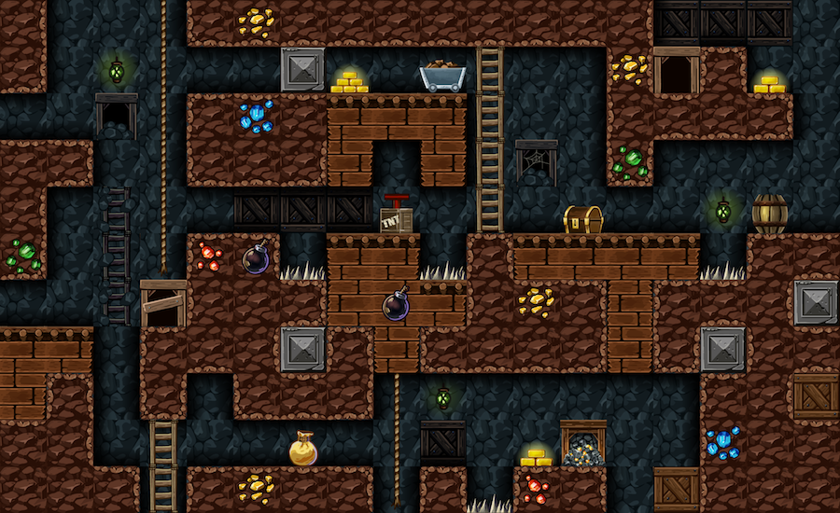
Summary:
Work out if the game object falls within the viewport.
If so, work out what portion should be drawn.
Then, work out what region of the screen it should be drawn to.
Finally, draw.

Slide 11
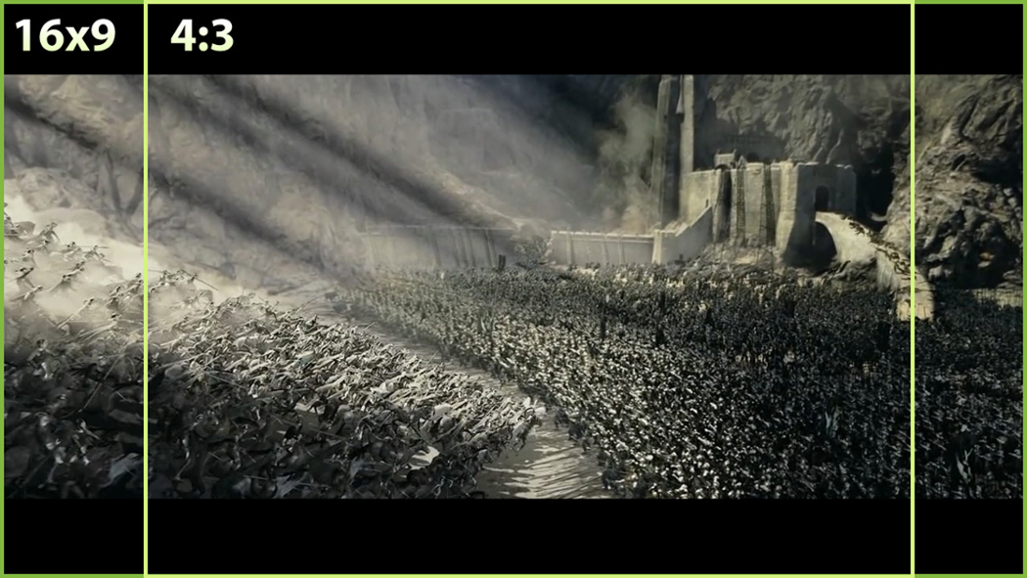
Handling display aspect ratios

Slide 12


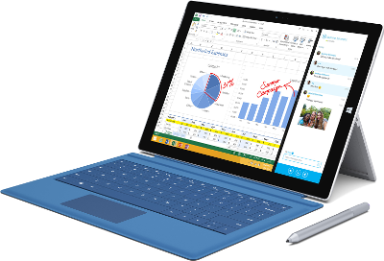
A number of different display aspect ratios are used, including:
4:3
3:2
16:10
16:9

Slide 13
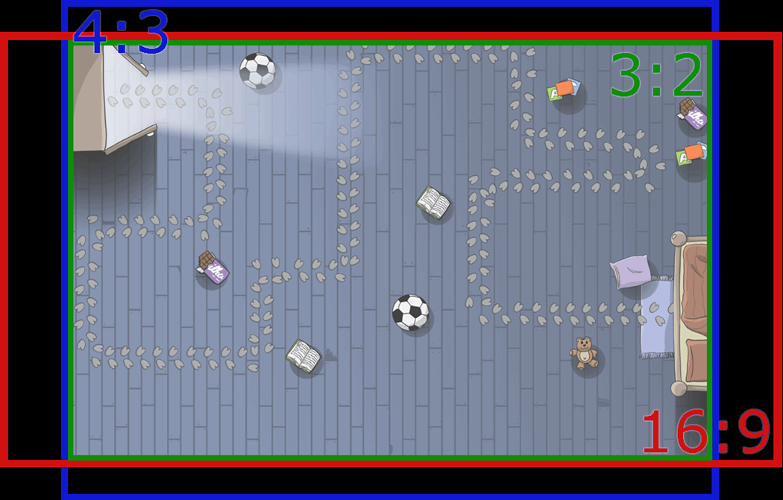
The display aspect will determine how much ‘vertical’ and ‘horizontal’ space is available to display your game.

Slide 14
4:3
By assume a 3:2 aspect ratio the other aspect ratios provide additional vertical or horizontal display space.
Hence, design your game to be played within a virtual viewport of, say, 480x320 (landscape) or 320x480 (portrait).
3:2
16:9
16:10

Slide 15





Some of the ways of handling the display of different aspects ratios include:
Scaling
Black bars
Resized viewport
Scaling and using black bars will ensure the same information is always displayed but can lessen the visual impact of the game. A resized viewport is likely to look best, although, different players may see different bits of the world.

Slide 16

Key takeaways:
The viewport determines which bit of your game world gets to be displayed.
Whilst straightforward in principle, different display aspects and varying coordinate systems complicate matters somewhat.

